Slide 1
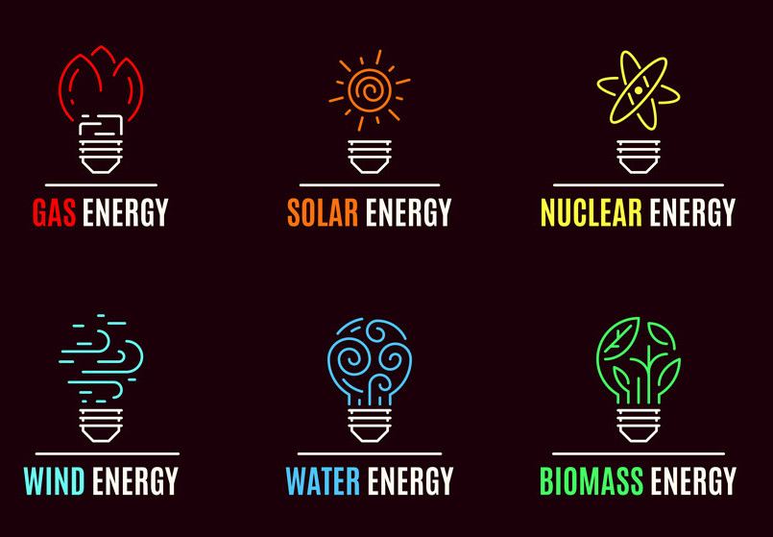

Prediction of Energy Consumption in California
TEAM 1
Frank Dong, Yang Weng, Nima Hendi, Sean Lee
University of California, Irvine collaboration with Accenture pls

Slide 2
Summary
Industry Energy Consumption Predictor
(1) collect historical data on energy consumption and related potential data
(2) preprocess and clean the data
(3) identify relevant features and engineer new ones
(4) develop and train machine learning models, eg MLP
(5) evaluate the performance of the models and fine-tune them as necessary.
Ultimately, the goal is to provide accurate predictions that can help make informed decisions and optimize energy usage.

Slide 3
Technical Approach
Combine the industry energy related data sets.
Industry energy consumption data EDA (Exploratory data analysis).
Logistic and linear model, MLP neural network models comparison.
Plot prediction with real data.
Notes:
Combine the industry energy related data sets.(Gather the industry energy related data sets from multiple sources, clean and organize the data, and then combine them using a data integration tool to create a comprehensive dataset.) When combining industry energy-related datasets, it's important to first gather the data from multiple sources and clean and organize it to ensure that the data is consistent and accurate. This involves checking for duplicates, filling in missing values, and ensuring that the data is formatted consistently across all sources. Once the data has been cleaned and organized, a data integration tool such as Talend, Informatica, or Pentaho can be used to combine the data into a single comprehensive dataset.
To implement an MLP neural network model for industry energy consumption, we first need to preprocess the data by scaling and normalizing it to ensure that all data points are within the same range. The data can then be split into training and testing sets, with the training set used to train the MLP model and the testing set used to validate the model's accuracy.
Then visualizing the MLP model, plot the predicted values against the actual values to see how well the model is performing.

Slide 4
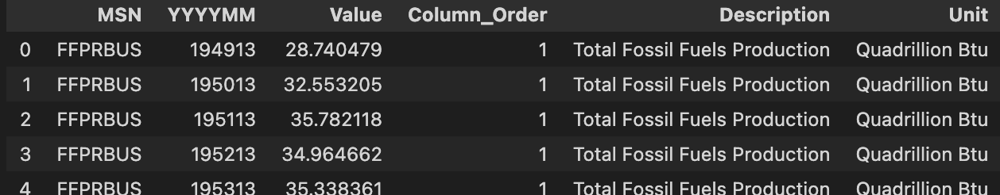
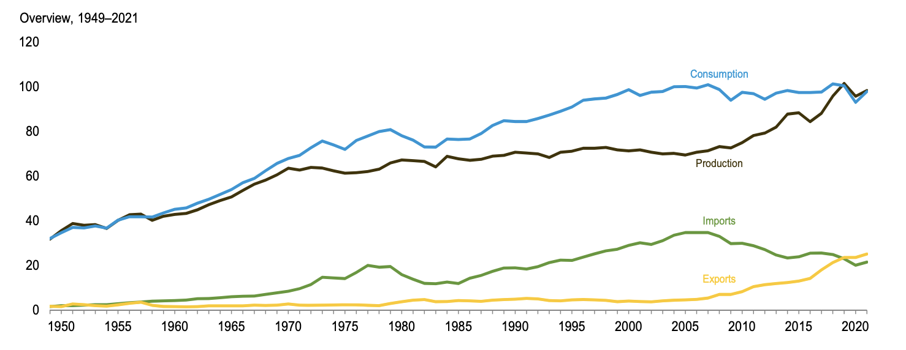
Data Sets
url for the datasets: https://www.eia.gov/totalenergy/data/monthly/
U.S energy summary
U.S energy consumption summary
Industry energy consumption by category
Energy trade by category
Energy prices by category
Industry emissions by source
Data frame of US Energy Summary
Graph provided on the website
Notes:
Our sponsor Accenture provided us with a link to a public dataset that we should be using for our project. It leads to the US Energy Information Administration website. From the countless datasets, we picked out 6 of them to use for our project. We decided to focus on the data for energy consumption and factors that could have an affect on the consumption such as prices. A data frame for US Energy Summary is given on the screen here along with a graph. The data frame contains 6 attributes in total. MSN is a name given based on the type of energy used, energy activity, type of data, and location of the data collected. The second column is the year and month, value is the numerical data given. The column_order groups the data for each MSN. Description is used to describe the data given. And unit is the measurement used for the value attribute.

Slide 5
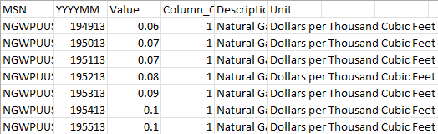
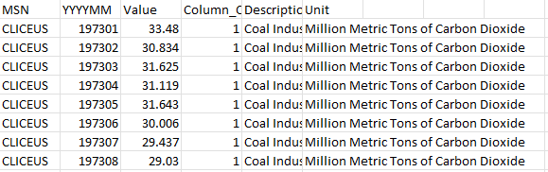
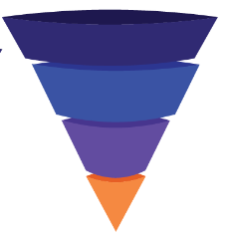
Data Sets (Cont.)
Data frame of Energy prices by category
Data frame of Industry emissions by source
Linked together through the date attribute, “YYYYMM”
Notes:
Here are data frames of two more data sets we will be using. As it can be seen, the attributes are the same for all the data sets. We will be linking all of the data together by using the date attribute which is the second column. We will then feed the linked data into our model.

Slide 6
Experiments and Evaluation
Use MSE to evaluate the model performance.
Use cross validation to avoid overfitting and underfitting. Divide training and testing in time series.
Modified training data along training to build better models, since our data cover a long period and old data might be noise for precise prediction.

Slide 7
Experiments and Evaluation (part 2)
Provide a brief and clear description of how you plan to evaluate the results of your project. For example, if you are doing classification, you should consider metrics such as classification accuracy and precision-recall, in addition to having access to training data. Will you use cross-validation, or does your data set(s) come with a fixed train-test partition? For unsupervised learning tasks like clustering or topic modeling, you may have to do some research to see how evaluation is done on these tasks. For some projects you may even have to do some user studies for evaluation, e.g., present users with results from Algorithm A and Algorithm B, using the same input data for each algorithm, without telling the user which algorithm is which, and have them select the one they prefer. Or your evaluation may be more qualitative in that you hope to generate insights about a particular problem.

Slide 8







Software and Programming Libraries
Visual Studio Code \ JetBrains
PostgreSQL Desktop+ Shell
GitHub Desktop
Anaconda Navigator
Jupyter Notebook
Software
Python
Pandas
Numpy
Matplotlib
PyTorch
Sklearn
R Studio
Tidyverse
Tidypredict
dplyr
Programming Libraries
Code we will write: appropriate schemas, pipelines, web application, prediction implementation

Slide 9
Milestones
Winter
Weeks 8-10 Data sets Collection and Combination
Spring
Weeks 1-2 Data sets EDA
Weeks 3-4 Statistic Model fit, and Machine learning Model fit
Weeks 5-6 Model validation and visualization
Weeks 7-8 Model analyze
Weeks 9-10 Final report

